Slide 1
CS 3006 Parallel and Distributed Computing Lecture 22
Danyal Farhat
FAST School of Computing
NUCES Lahore

Slide 2
Programming Distributed Machines Using Message Passing Interface (MPI) – Part 2

Slide 3
Outline
Ensuring Operation Semantics
Blocking and Non-blocking Operations
MPI Rules for Send/Receive
Deadlocks (Circular)
Deadlocks - Solution
Avoiding deadlocks : SendReceive operation

Slide 4

Ensuring Operation Semantics
Consider the following code segments:
Send (void *sendbuf, int nelems, int dest)
Receive (void *recvbuf, int nelems, int source)
The semantics of the send operation require that the value received by process P1 must be 100 as opposed to 0
There may be an issue if infrastructure has network interface hardware for asynchronous send/receive without the involvement of CPU
After programming the network hardware, the control may return immediately to the next instruction, causing changes in the buffer before it is communicated to P1

Slide 5
Blocking and Non-blocking Operations
Solutions (Assigned Reading: 6.2 The building blocks : send Receive Operations)
Blocking without Buffering
Simple and easy to enforce
Suffers idling and deadlocks
Blocking with Buffering
Reduces process idling at the cost of buffer management overheads
In presence of communication hardware, it stores message in a buffer at sender, and communication is done asynchronously when receiver approaches to corresponding receive.
In absence of communication hardware, sender interrupts the receiver and deposits data in buffer at receiver.
Issues: (bounded buffer and unexpected delays + blocking receives)
Non-blocking with and without buffers
Difficult to ensure semantics
Almost entirely masks the communication overheads
Recommended not to use

Slide 6
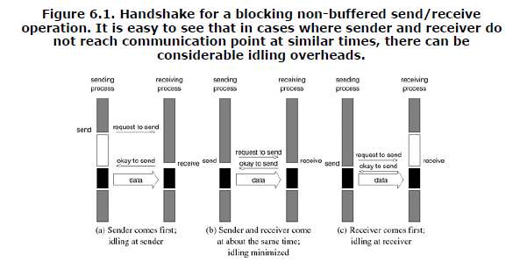
Blocking and Non-blocking Operations (Cont.)

Slide 7
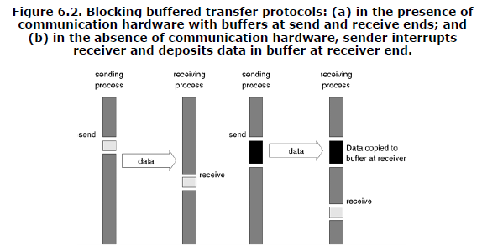
Blocking and Non-blocking Operations (Cont.)
Notes:
6.a)
On encountering a send operation, the sender copies data into the buffer and continue with the program knowing that any changes to
the data will not impact program semantics.
When receiving process encounters a receive operation, it checks to see if the message is available in its receive buffer. If so, the data is copied into the target location.
6.b)
On encountering a send operation, the sender interrupts the receiver, both processes participate in a communication operation and the message is deposited in a buffer at the receiver end.

Slide 8
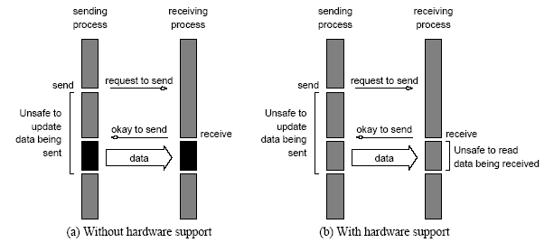
Blocking and Non-blocking Operations (Cont.)
Non-Blocking (without a buffer)

Slide 9
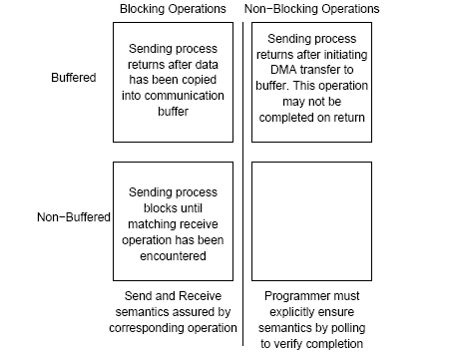
Blocking and Non-blocking Operations (Cont.)
Space of possible protocols for send and receive operations

Slide 10
MPI Rules for Send/Receive
MPI usually uses blocking buffered Send only if there is enough buffer space to store whole message
Otherwise, it uses blocking send
Receive is always blocking
Deadlocks and Avoidance

Slide 11
Deadlocks (Circular)
Consider the following piece of code, in which process i sends a message to process i + 1 (modulo the number of processes) and receives a message from process i - 1 (module the number of processes).
int a[10], b[10], npes, myrank;
MPI_Status status;
...
MPI_Comm_size(MPI_COMM_WORLD, &npes);
MPI_Comm_rank(MPI_COMM_WORLD, &myrank);
MPI_Send(a, 10, MPI_INT, (myrank+1)%npes, 1, MPI_COMM_WORLD);
MPI_Recv(b, 10, MPI_INT, (myrank-1+npes)%npes, 1, MPI_COMM_WORLD);
...
Once again, we have a deadlock if MPI_Send is blocking

Slide 12
Deadlocks → Solution
We can break the circular wait to avoid deadlocks as follows:
int a[10], b[10], npes, myrank;
MPI_Status status;
...
MPI_Comm_size(MPI_COMM_WORLD, &npes);
MPI_Comm_rank(MPI_COMM_WORLD, &myrank);
if (myrank%2 == 1) {
MPI_Send(a, 10, MPI_INT, (myrank+1)%npes, 1, MPI_COMM_WORLD);
MPI_Recv(b, 10, MPI_INT, (myrank-1+npes)%npes, 1, MPI_COMM_WORLD);
}
else {
MPI_Recv(b, 10, MPI_INT, (myrank-1+npes)%npes, 1, MPI_COMM_WORLD);
MPI_Send(a, 10, MPI_INT, (myrank+1)%npes, 1, MPI_COMM_WORLD);
}
...

Slide 13
Avoiding deadlocks : SendReceive operation
To avoid earlier deadlocks, MPI provides MPI_Sendrecv function
It can both send and receive message
Does not suffers from the circular deadlock problems
One can think MPI_Sendrecv as allowing data to travel for both send and receive simultaneously.
int MPI_Sendrecv(void *sendbuf, int sendcount,
MPI_Datatype senddatatype, int dest,int sendtag,
void *recvbuf, int recvcount,
MPI_Datatype recvdatatype, int source, int recvtag, MPI_Comm comm, MPI_Status *status)

Slide 14
Avoiding deadlocks : SendReceive operation
MPI_Sendrecv_replace function
If we wish to use the same buffer for both send and receive
First sends value[s] of current buffer and then overwrites them with received ones
Syntax
int MPI_Sendrecv_replace(void *buf, int count, MPI_Datatype datatype, int dest, int sendtag,int source, int recvtag, MPI_Comm comm, MPI_Status *status)

Slide 15
Summary
Ensuring Operation Semantics
Asynchronous send/receive operation can have issue of data integrity
Blocking and Non-blocking Operations
Blocking without Buffering
Blocking with Buffering
Non-blocking with and without buffers
MPI Rules for Send/Receive
Sender uses blocking buffered send or blocking send
Receiver is always blocking

Slide 16
Summary (Cont.)
Deadlocks (Circular)
Deadlocks - Solution
Avoiding deadlocks : SendReceive operation
int MPI_Sendrecv(void *sendbuf, int sendcount, MPI_Datatype senddatatype, int dest,int sendtag, void *recvbuf, int recvcount, MPI_Datatype recvdatatype, int source, int recvtag, MPI_Comm comm, MPI_Status *status)
int MPI_Sendrecv_replace(void *buf, int count, MPI_Datatype datatype, int dest, int sendtag,int source, int recvtag, MPI_Comm comm, MPI_Status *status)

Slide 17
Additional Resources
Introduction to Parallel Computing by Ananth Grama and Anshul Gupta
Chapter 6: Programming Using Message Passing Paradigm

Slide 18
Questions?

